Slide 1

FUNDAMENTALS OF DATABASE SYSTEMS LESSON 7: The Relational Algebra and Calculus
Nguyễn Thị Hậu
University of Engineering and Technology,
Vietnam National University in Hanoi (UET-VNU)
nguyenhau@vnu.edu.vn

Slide 2
Chapter Outline
Example Database Application (COMPANY)
Relational Algebra
Unary Relational Operations
Relational Algebra Operations From Set Theory
Binary Relational Operations
Additional Relational Operations
Examples of Queries in Relational Algebra
Relational Calculus
Tuple Relational Calculus
Domain Relational Calculus
Overview of the QBE language (appendix D)

Slide 3
Relational Algebra
The basic set of operations for the relational model is known as the relational algebra. These operations enable a user to specify basic retrieval requests.
The result of a retrieval is a new relation, which may have been formed from one or more relations. The algebra operations thus produce new relations, which can be further manipulated using operations of the same algebra.
A sequence of relational algebra operations forms a relational algebra expression, whose result will also be a relation that represents the result of a database query (or retrieval request).

Slide 4
Unary Relational Operations
SELECT Operation
SELECT operation is used to select a subset of the tuples from a relation that satisfy a selection condition. It is a filter that keeps only those tuples that satisfy a qualifying condition – those satisfying the condition are selected while others are discarded.
Example: To select the EMPLOYEE tuples whose department number is four or those whose salary is greater than $30,000 the following notation is used:
σDNO = 4 (EMPLOYEE)
σSALARY > 30,000 (EMPLOYEE)
In general, the select operation is denoted by _{σ <selection condition>}(R) where the
symbol σ (sigma) is used to denote the select operator, and the selection condition is a Boolean expression specified on the attributes of relation R

Slide 5
Unary Relational Operations
SELECT Operation Properties
The SELECT operation σ _{<selection condition>}(R) produces a relation S that has the same schema as R
The SELECT operation σ is commutative; i.e.,
σ _{<condition1>}(σ _{< condition2>} ( R)) = σ _{<condition2>} (σ _{< condition1>} ( R))
A cascaded SELECT operation may be applied in any order; i.e.,
σ _{<condition1>}(σ _{< condition2>} (σ _{<condition3>} ( R))
= σ _{<condition2>} (σ _{< condition3>} (σ _{< condition1>} ( R)))
A cascaded SELECT operation may be replaced by a single selection with a conjunction of all the conditions; i.e.,
σ _{<condition1>}(σ _{< condition2>} (σ _{<condition3>} ( R))
= σ <condition1> AND < condition2> AND < condition3> ( R)))

Slide 6
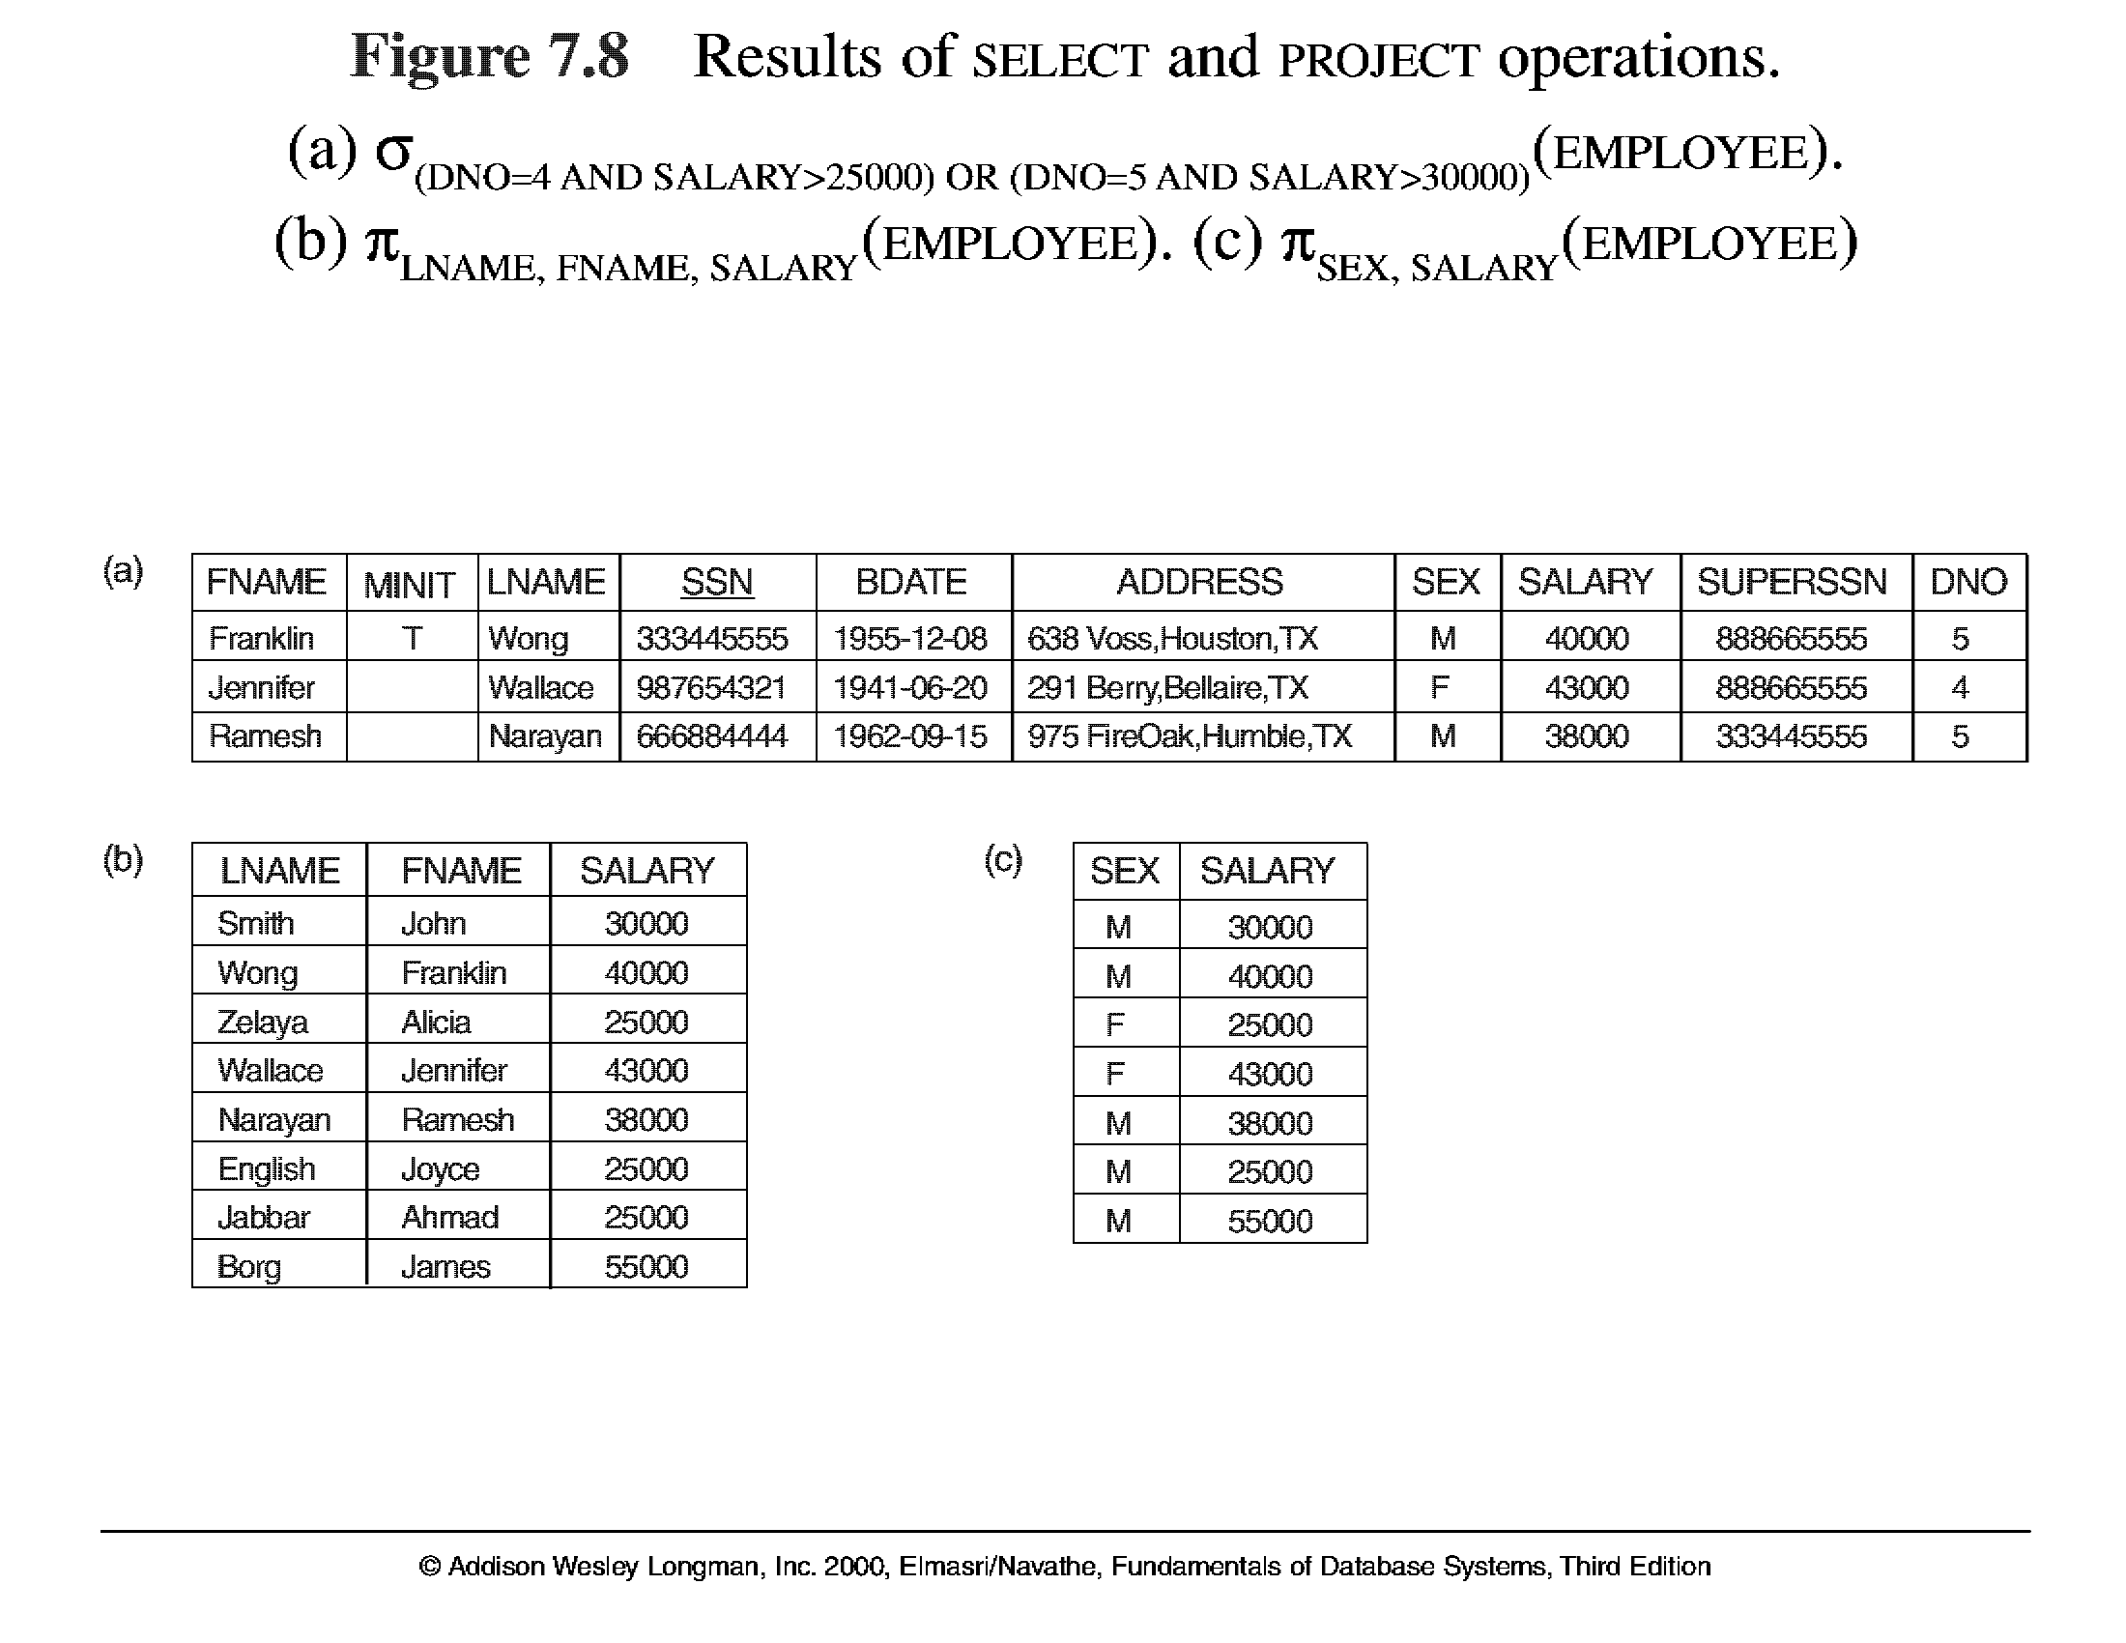
Unary Relational Operations (cont.)

Slide 7
Unary Relational Operations (cont.)
PROJECT Operation
This operation selects certain columns from the table and discards the other columns. The PROJECT creates a vertical partitioning – one with the needed columns (attributes) containing results of the operation and other containing the discarded Columns.
Example: To list each employee’s first and last name and salary, the following is used:
π_{LNAME, FNAME,SALARY}(EMPLOYEE)
The general form of the project operation is π<attribute list>(R) where π (pi) is the symbol used to represent the project operation and <attribute list> is the desired list of attributes from the attributes of relation R.
The project operation removes any duplicate tuples, so the result of the project operation is a set of tuples and hence a valid relation.

Slide 8
Unary Relational Operations (cont.)
PROJECT Operation Properties
The number of tuples in the result of projection π _{<list>} (R)is always less or equal to the number of tuples in R.
If the list of attributes includes a key of R, then the number of tuples is equal to the number of tuples in R.
π _{<list1>} (π _{<list2>} (R) ) = π _{<list1>} (R) as long as <list2> contains the attributes in <list2>

Slide 9
Unary Relational Operations (cont.)

Slide 10
Unary Relational Operations (cont.)
Rename Operation
We may want to apply several relational algebra operations one after the other. Either we can write the operations as a single relational algebra expression by nesting the operations, or we can apply one operation at a time and create intermediate result relations. In the latter case, we must give names to the relations that hold the intermediate results.
Example: To retrieve the first name, last name, and salary of all employees who work in department number 5, we must apply a select and a project operation. We can write a single relational algebra expression as follows:
π_{FNAME, LNAME, SALARY}(σ _{DNO=5}(EMPLOYEE))
OR We can explicitly show the sequence of operations, giving a name to each intermediate relation:
DEP5_EMPS ← σ _{DNO=5}(EMPLOYEE)
RESULT ← π _{FNAME, LNAME, SALARY} (DEP5_EMPS)

Slide 11
Unary Relational Operations (cont.)
Rename Operation (cont.)
The rename operator is ρ
The general Rename operation can be expressed by any of the following forms:
ρ _{S (B1, B2, …, Bn )} ( R) is a renamed relation S based on R with column names B₁, B₁, …..B_{n}.
ρ _{S} ( R) is a renamed relation S based on R (which does not specify column names).
ρ _{(B1, B2, …, Bn )} ( R) is a renamed relation with column names B₁, B₁, …..B_{n} which does not specify a new relation name.

Slide 12
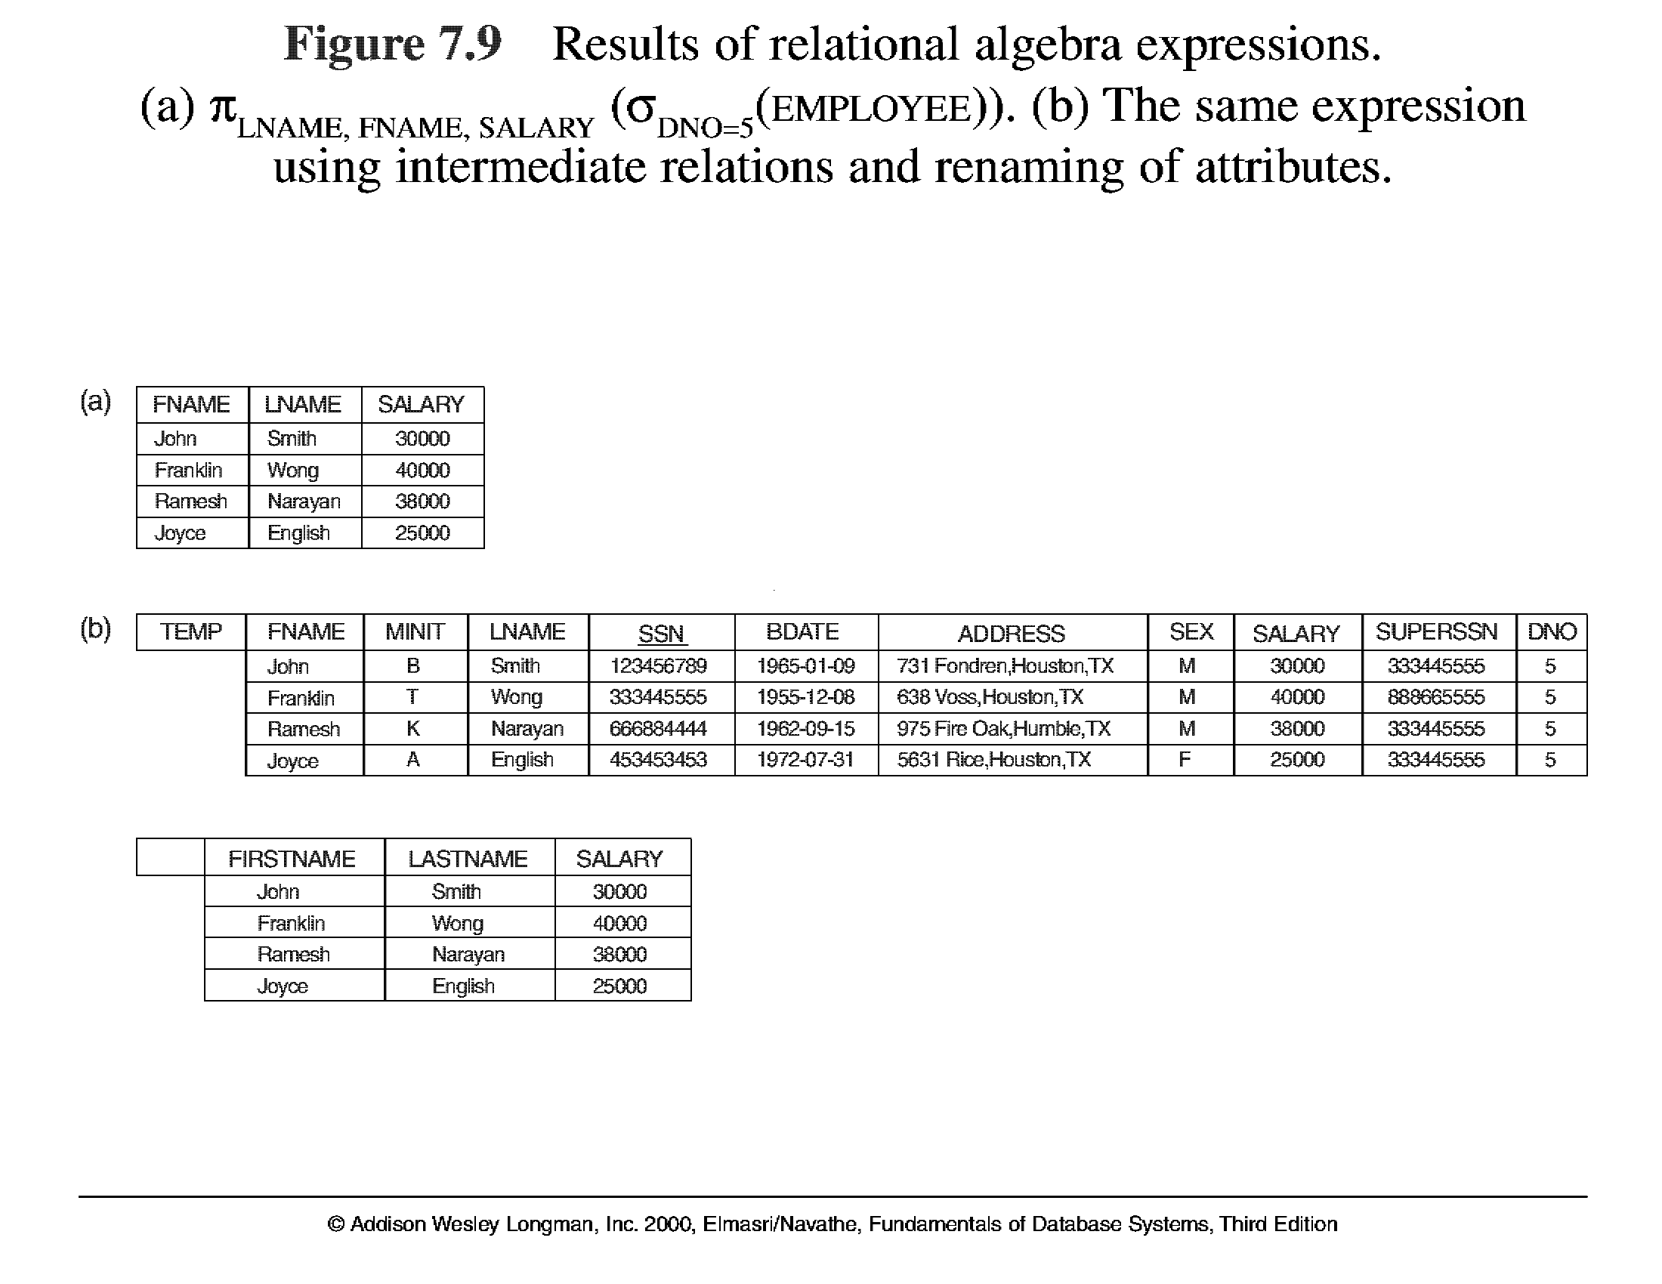
Unary Relational Operations (cont.)

Slide 13
Chapter Outline
Example Database Application (COMPANY)
Relational Algebra
Unary Relational Operations
Relational Algebra Operations From Set Theory
Binary Relational Operations
Additional Relational Operations
Examples of Queries in Relational Algebra
Relational Calculus
Tuple Relational Calculus
Domain Relational Calculus
Overview of the QBE language (appendix D)

Slide 14
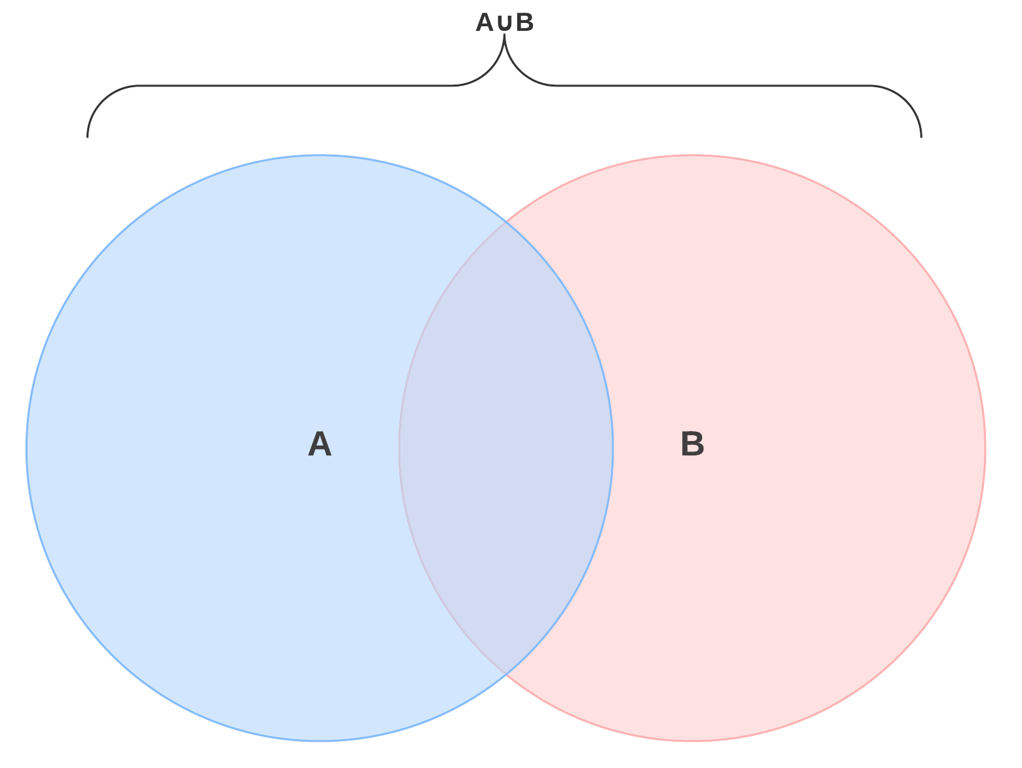
Relational Algebra Operations From Set Theory
UNION Operation
The result of this operation, denoted by R ∪ S, is a relation that includes all tuples that are either in R or in S or in both R and S. Duplicate tuples are eliminated.
Example: To retrieve the social security numbers of all employees who either work in department 5 or directly supervise an employee who works in department 5, we can use the union operation as follows:
DEP5_EMPS ← σ_{DNO=5} (EMPLOYEE)
RESULT1 ← π _{SSN}(DEP5_EMPS)
RESULT2(SSN) ← π _{SUPERSSN}(DEP5_EMPS)
RESULT ← RESULT1 ∪ RESULT2
The union operation produces the tuples that are in either RESULT1 or RESULT2 or both. The two operands must be “type compatible”.

Slide 15
Relational Algebra Operations From Set Theory
Type Compatibility
The operand relations R₁(A₁, A₂, ..., A_{n}) and R₂(B₁, B₂, ..., B_{n}) must have the same number of attributes, and
the domains of corresponding attributes must be compatible; that is, dom(A_{i})=dom(B_{i}) for i=1, 2, ..., n.
The resulting relation for R₁∪R₂,R₁ ∩ R₂, or R₁-R₂ has the same attribute names as the first operand relation R1 (by convention).

Slide 16
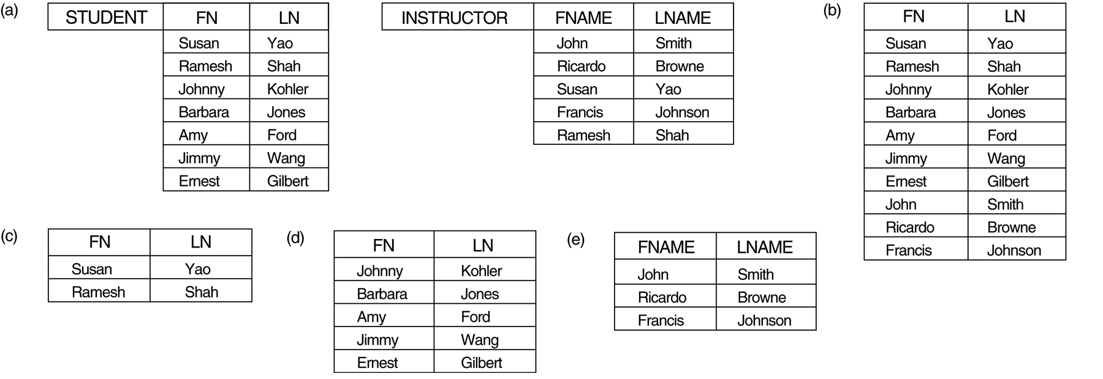
Relational Algebra Operations From Set Theory
UNION Example
STUDENT ∪ INSTRUCTOR

Slide 17
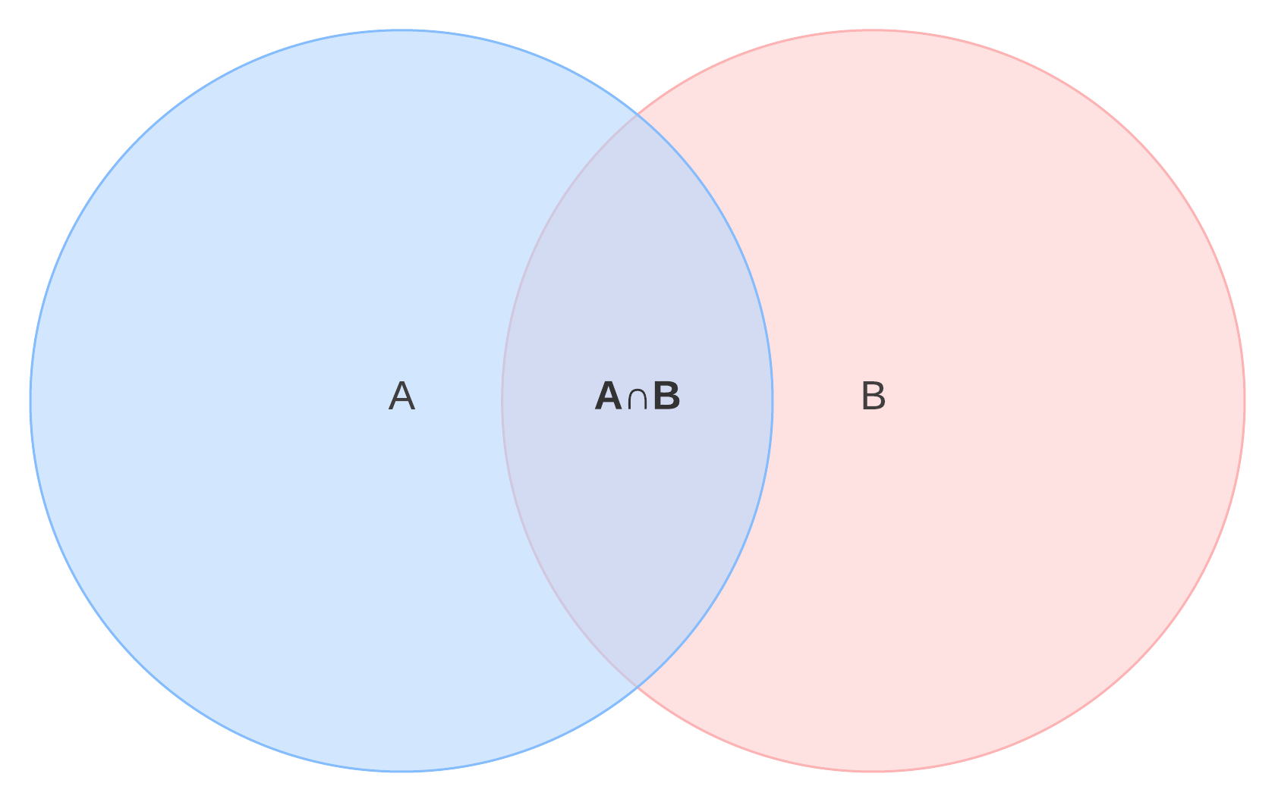
Relational Algebra Operations From Set Theory (cont.)
INTERSECTION OPERATION
The result of this operation, denoted by R ∩ S, is a relation that includes all tuples that are in both R and S. The two operands must be "type compatible"
Example: The result of the intersection operation (figure below) includes only those who are both students and instructors.
STUDENT ∩ INSTRUCTOR

Slide 18
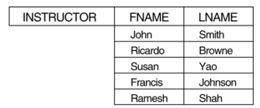
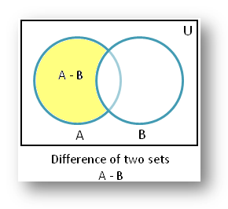
Relational Algebra Operations From Set Theory (cont.)
Set Difference (or MINUS) Operation
The result of this operation, denoted by R - S, is a relation that includes all tuples that are in R but not in S. The two operands must be "type compatible”.
Example: The figure shows the names of students who are not instructors, and the names of instructors who are not students.
INSTRUCTOR - STUDENT
STUDENT - INSTRUCTOR

Slide 19
Relational Algebra Operations From Set Theory (cont.)
Notice that both union and intersection are commutative operations; that is
R ∪ S = S ∪ R, and R ∩ S = S ∩ R
Both union and intersection can be treated as n-ary operations applicable to any number of relations as both are associative operations; that is
R ∪ (S ∪ T) = (R ∪ S) ∪ T, and (R ∩ S) ∩ T = R ∩ (S ∩ T)
The minus operation is not commutative; that is, in general
R - S ≠ S – R

Slide 20
Relational Algebra Operations From Set Theory (cont.)
CARTESIAN (or cross product) Operation
This operation is used to combine tuples from two relations in a combinatorial fashion. In general, the result of R(A₁, A₂, . . ., A_{n}) x S(B₁, B₂, . . ., B_{m}) is a relation Q with degree n + m attributes Q(A₁, A₂, . . ., A_{n}, B₁, B₂, . . ., B_{m}), in that order. The resulting relation Q has one tuple for each combination of tuples—one from R and one from S.
Hence, if R has n_{R} tuples (denoted as |R| = n_{R} ), and S has n_{S} tuples, then
| R x S | will have n_{R} * n_{S} tuples.
The two operands do NOT have to be "type compatible”

Slide 21
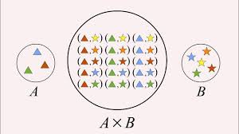
CARTESIAN PRODUCT OPERATION

Slide 22
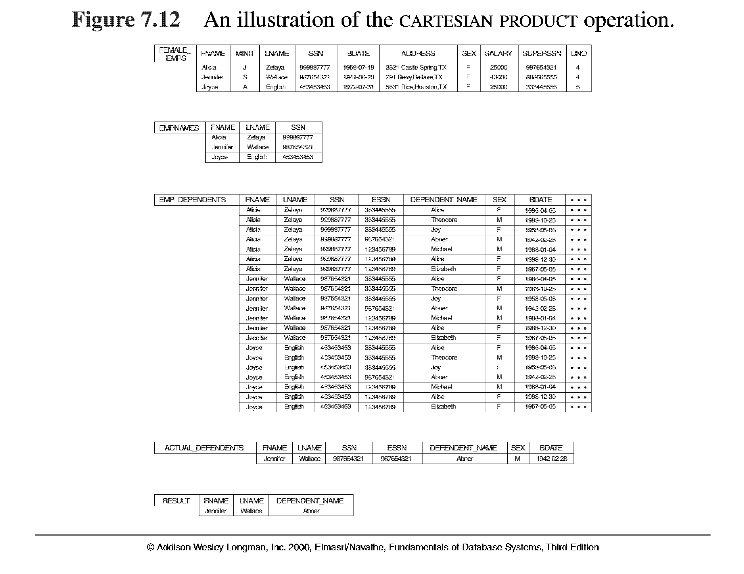
Relational Algebra Operations From Set Theory (cont.)
FEMALE_EMPS ← σ _{SEX=’F’}(EMPLOYEE)
EMPNAMES ← π _{FNAME, LNAME, SSN} (FEMALE_EMPS)
EMP_DEPENDENTS ← EMPNAMES x DEPENDENT

Slide 23
Exercise 1
Tính:
R ∪ S, R S, R ∩ S
R - S, S – R
R x S
R
A
B
S
A
B
α
1
α
2
α
2
β
3
β
3

Slide 24
Chapter Outline
Example Database Application (COMPANY)
Relational Algebra
Unary Relational Operations
Relational Algebra Operations From Set Theory
Binary Relational Operations
Additional Relational Operations
Examples of Queries in Relational Algebra
Relational Calculus
Tuple Relational Calculus
Domain Relational Calculus
Overview of the QBE language (appendix D)

Slide 25
Binary Relational Operations
JOIN Operation
The sequence of cartesian product followed by select is used quite commonly to identify and select related tuples from two relations, a special operation, called JOIN. It is denoted by a
This operation is very important for any relational database with more than a single relation, because it allows us to process relationships among relations.
The general form of a join operation on two relations R(A₁, A₂, . . ., A_{n}) and S(B₁, B₂, . . ., B_{m}) is:
R _{<join condition>}S
where R and S can be any relations that result from general relational algebra expressions.

Slide 26
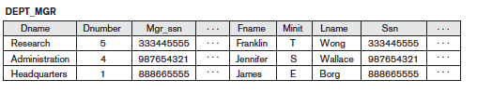
Binary Relational Operations (cont.)
Example: Suppose that we want to retrieve the name of the manager of each department. To get the manager’s name, we need to combine each DEPARTMENT tuple with the EMPLOYEE tuple whose SSN value matches the MGRSSN value in the department tuple. We do this by using the join operation.
DEPT_MGR ← DEPARTMENT _{MGRSSN=SSN} EMPLOYEE

Slide 27
Binary Relational Operations (cont.)
EQUIJOIN Operation
The most common use of join involves join conditions with equality comparisons only. Such a join, where the only comparison operator used is =, is called an EQUIJOIN. In the result of an EQUIJOIN we always have one or more pairs of attributes (whose names need not be identical) that have identical values in every tuple.
The JOIN seen in the previous example was EQUIJOIN.
NATURAL JOIN Operation
Because one of each pair of attributes with identical values is superfluous, a new operation called natural join—denoted by *—was created to get rid of the second (superfluous) attribute in an EQUIJOIN condition.
The standard definition of natural join requires that the two join attributes, or each pair of corresponding join attributes, have the same name in both relations. If this is not the case, a renaming operation is applied first.

Slide 28
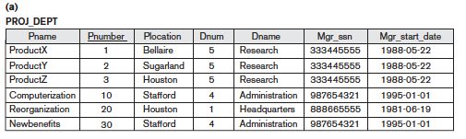
Binary Relational Operations (cont.)
PROJ_DEPT ← PROJECT * DEPT

Slide 29
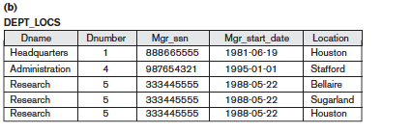
Binary Relational Operations (cont.)
DEPT_LOCS ← DEPARTMENT * DEPT_LOCATIONS

Slide 30
Exercise 2
R _{B<D} S
R _{C=D} S
R _{C=S.C} S
R
A
B
C
S
D
E
1
2
3
3
1
4
5
6
6
2
7
8
9

Slide 31
Complete Set of Relational Operations
The set of operations including select σ, project π , union ∪, set difference - , and cartesian product X is called a complete set because any other relational algebra expression can be expressed by a combination of these five operations.
For example:
R ∩ S = (R ∪ S ) – ((R − S) ∪ (S − R))
R _{<join condition>}S = σ _{<join condition>} (R X S)

Slide 32
Binary Relational Operations (cont.)
DIVISION Operation
The division operation is applied to two relations
R(Z) ÷ S(X), where X subset Z. Let Y = Z - X (and hence Z = X ∪ Y); that is, let Y be the set of attributes of R that are not attributes of S.
The result of DIVISION is a relation T(Y) that includes a tuple t if tuples t_{R} appear in R with t_{R} [Y] = t, and with
t_{R} [X] = t_{s} for every tuple t_{s} in S.
For a tuple t to appear in the result T of the DIVISION, the values in t must appear in R in combination with every tuple in S.

Slide 33
DIVISION Operation
T(Y)= R(Z) ÷ S(X)
Y = Z-X
T1 = π _{Y}(R)
T2 = π _{Y}((S × T1)-R)
T= T1-T2

Slide 34
DIVISION Operation
R | A | B | C | D
 | a1 | b1 | x1 | y1
 | a2 | b2 | x1 | y1
 | a1 | b2 | x1 | y1
 | a2 | b2 | x1 | y2
 | a1 | b1 | x1 | y2
 | a1 | b1 | x2 | y1
 | a2 | b2 | x2 | y1
 | a1 | b1 | x2 | y2
 | a2 | b3 | x1 | y2
 | a3 | b1 | x1 | y1
S | A | B
 | a1 | b1
 | a2 | b2
T = R ÷ S ?

Slide 35
DIVISION Operation
R | A | B | C | D
 | a1 | b1 | x1 | y1
 | a2 | b2 | x1 | y1
 | a1 | b2 | x1 | y1
 | a2 | b2 | x1 | y2
 | a1 | b1 | x1 | y2
 | a1 | b1 | x2 | y1
 | a2 | b2 | x2 | y1
 | a1 | b1 | x2 | y2
 | a2 | b3 | x3 | y2
 | a3 | b1 | x1 | y3
S | A | B
 | a1 | b1
 | a2 | b2
1. Y = {C,D }
2. T1 = π _{Y} (R)
T1 | C | D
 | x1 | y1
 | x1 | y2
 | x2 | y1
 | x2 | y2
 | x3 | y2
 | x1 | y3

Slide 36
DIVISION Operation
1. Y = {C,D }
2. T1 = π _{Y} (R)
3. T2 = π _{Y} (S × T1) - R)
R | A | B | C | D
 | a1 | b1 | x1 | y1
 | a2 | b2 | x1 | y1
 | a1 | b2 | x1 | y1
 | a2 | b2 | x1 | y2
 | a1 | b1 | x1 | y2
 | a1 | b1 | x2 | y1
 | a2 | b2 | x2 | y1
 | a1 | b1 | x2 | y2
 | a2 | b3 | x3 | y2
 | a3 | b1 | x1 | y3
S | A | B
 | a1 | b1
 | a2 | b2
 | A | B | C | D
 | a1 | b1 | x1 | y1
 | a1 | b1 | x1 | y2
 | a1 | b1 | x2 | y1
 | a1 | b1 | x2 | y2
 | a1 | b1 | x3 | y2
 | a1 | b1 | x1 | y3
 | a2 | b2 | x1 | y1
 | a2 | b2 | x1 | y2
 | a2 | b2 | x2 | y1
 | a2 | b2 | x2 | y2
 | a2 | b2 | x3 | y2
 | a2 | b2 | x1 | y3
T1 | C | D
 | x1 | y1
 | x1 | y2
 | x2 | y1
 | x2 | y2
 | x3 | y2
 | x1 | y3

Slide 37
DIVISION Operation
1. Y = {C,D }
2. T1 = π _{Y} (R)
3. T2 = π _{Y} ((S × T1) - R)
R | A | B | C | D
 | a1 | b1 | x1 | y1
 | a2 | b2 | x1 | y1
 | a1 | b2 | x1 | y1
 | a2 | b2 | x1 | y2
 | a1 | b1 | x1 | y2
 | a1 | b1 | x2 | y1
 | a2 | b2 | x2 | y1
 | a1 | b1 | x2 | y2
 | a2 | b3 | x3 | y2
 | a3 | b1 | x1 | y3
S | A | B
 | a1 | b1
 | a2 | b2
 | A | B | C | D
 | a1 | b1 | x3 | y2
 | a1 | b1 | x1 | y3
 | a2 | b2 | x2 | y2
 | a2 | b2 | x3 | y2
 | a2 | b2 | x1 | y3
T1 | C | D
 | x1 | y1
 | x1 | y2
 | x2 | y1
 | x2 | y2
 | x3 | y2
 | x1 | y3
4. T = T1-T2
T2 | C | D
 | x3 | y2
 | x1 | y3
 | x2 | y2
T | C | D
 | x1 | y1
 | x1 | y2
 | x2 | y1

Slide 38
Exercise 3
R
A
B
C
D
E
S
D
E
α
a
α
a
1
a
1
α
a
γ
a
1
b
1
α
a
γ
b
1
β
a
γ
a
1
β
a
γ
b
3
γ
a
γ
a
1
γ
a
γ
b
1
R ÷ S
γ
a
β
b
1

Slide 39
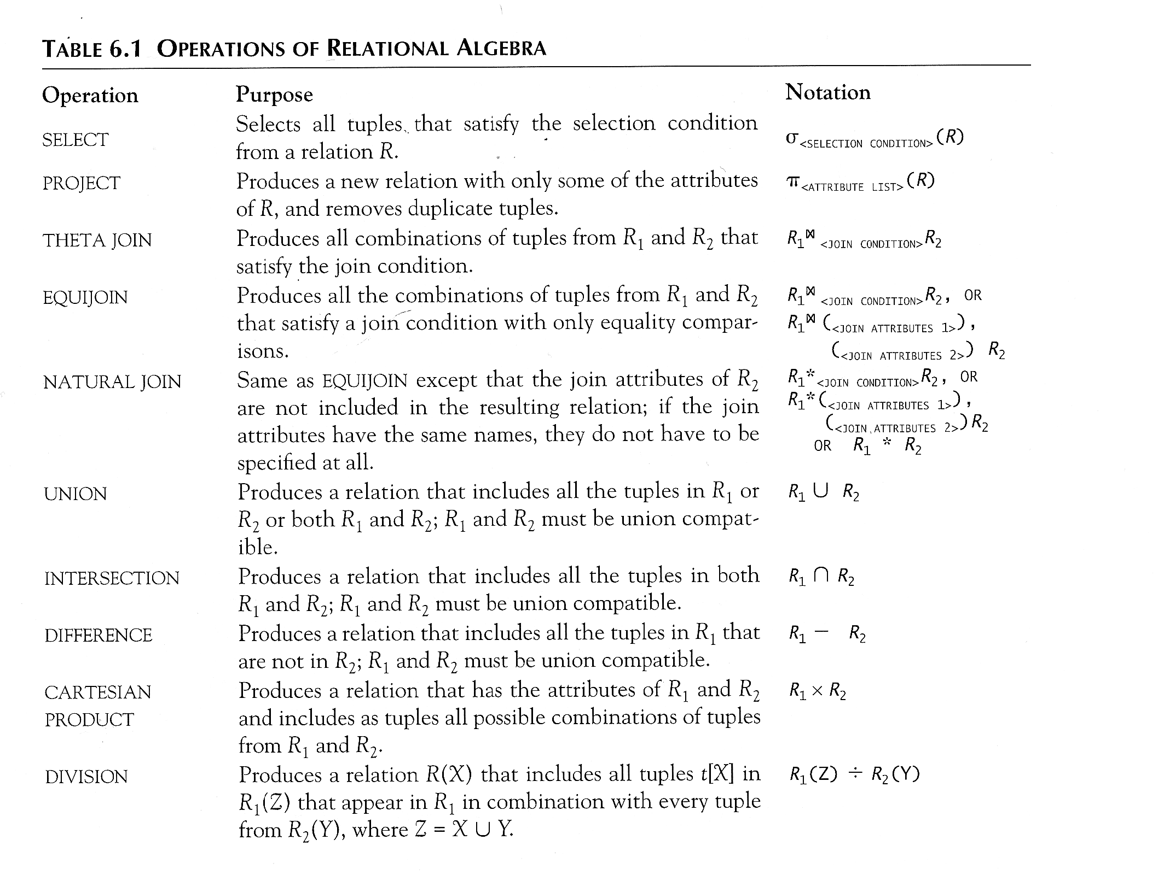
Recap of Relational Algebra Operations

Slide 40
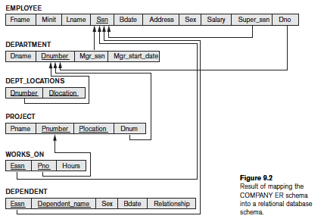
COMPANY Database

Slide 41
QUERY EXAMPLES
Retrieve the name and address of all employees who work for the ‘Research’ department.
RESEARCH_DEPT ← σ _{Dname=‘Research’}(DEPARTMENT)
RESEARCH_EMPS ← (RESEARCH_DEPT _{Dnumber=Dno} EMPLOYEE)
RESULT ← π _{Fname, Lname, Address}(RESEARCH_EMPS)

Slide 42
QUERY EXAMPLES
For every project located in ‘Hanoi’, list the project number, the controlling department number, and the department manager’s last name, address, and birth date.
Hanoi_PROJS ← σ_{Plocation=‘Hanoi’}(PROJECT)
CONTR_DEPTS ← (Hanoi_PROJS _{Dnum=Dnumber}DEPARTMENT)
PROJ_DEPT_MGRS ← (CONTR_DEPTS _{Mgr_ssn=Ssn} EMPLOYEE)
RESULT ← π Pnumber, Dnum, Lname, Address, Bdate (PROJ_DEPT_MGRS)

Slide 43
QUERY EXAMPLES
Retrieve the names of employees who have no dependents.
ALL_EMPS ← π _{Ssn} (EMPLOYEE)
EMPS_WITH_DEPS(Ssn) ← π _{Essn} (DEPENDENT)
EMPS_WITHOUT_DEPS ← (ALL_EMPS – EMPS_WITH_DEPS)
RESULT ← π _{Lname, Fname} (EMPS_WITHOUT_DEPS * EMPLOYEE)

Slide 44
QUERY EXAMPLES
List the names of managers who have at least one dependent.
MGRS(Ssn) ← π _{Mgr_ssn} (DEPARTMENT)
EMPS_WITH_DEPS(Ssn) ← π _{Essn} (DEPENDENT)
MGRS_WITH_DEPS ← (MGRS ∩ EMPS_WITH_DEPS)
RESULT ← π _{Lname, Fname} (MGRS_WITH_DEPS * EMPLOYEE)

Slide 45
QUERY EXAMPLES
Find the names of employees who work on all the projects controlled by department number 5.
DEPT5_PROJS ← ρ(Pno)(π_{Pnumber}(σ _{Dnum=5} (PROJECT)))
EMP_PROJ ← ρ(Ssn, Pno)(π _{Essn, Pno} (WORKS_ON))
RESULT_EMP_SSNS ← EMP_PROJ ÷ DEPT5_PROJS
RESULT ← π _{Lname, Fname} (RESULT_EMP_SSNS * EMPLOYEE)

Slide 46
QUERY EXAMPLES
Make a list of project numbers for projects that involve an employee whose last name is ‘Smith’, either as a worker or as a manager of the department that controls the project.
SMITHS(Essn) ← π _{Ssn} (σ _{Lname=‘Smith’} (EMPLOYEE))
SMITH_WORKER_PROJS ← π _{Pno} (WORKS_ON * SMITHS)
MGRS ← π _{Lname, Dnumber} (EMPLOYEE _{Ssn=Mgr_ssn} DEPARTMENT)
SMITH_MANAGED_DEPTS(Dnum) ← π _{Dnumber} (σ _{Lname=‘Smith’} (MGRS))
SMITH_MGR_PROJS(Pno) ← π _{Pnumber} (SMITH_MANAGED_DEPTS * PROJECT)
RESULT ← (SMITH_WORKER_PROJS ∪ SMITH_MGR_PROJS)

Slide 47
QUERY EXAMPLES
List the names of managers who have at least one dependent.
MGRS(Ssn) ← π _{Mgr_ssn} (DEPARTMENT)
EMPS_WITH_DEPS(Ssn) ← π _{Essn} (DEPENDENT)
MGRS_WITH_DEPS ← (MGRS ∩ EMPS_WITH_DEPS)
RESULT ← π _{Lname, Fname} (MGRS_WITH_DEPS * EMPLOYEE)

Slide 48
Chapter Outline
Example Database Application (COMPANY)
Relational Algebra
Unary Relational Operations
Relational Algebra Operations From Set Theory
Binary Relational Operations
Additional Relational Operations
Examples of Queries in Relational Algebra
Relational Calculus
Tuple Relational Calculus
Domain Relational Calculus
Overview of the QBE language (appendix D)

Slide 49

Aggregate Functions and Grouping
A type of request that cannot be expressed in the basic relational algebra is to specify mathematical aggregate functions on collections of values from the database.
Examples of such functions include retrieving the average or total salary of all employees or the total number of employee tuples. These functions are used in simple statistical queries that summarize information from the database tuples.
Common functions applied to collections of numeric values include SUM, AVERAGE, MAXIMUM, and MINIMUM. The COUNT function is used for counting tuples or values.

Slide 50
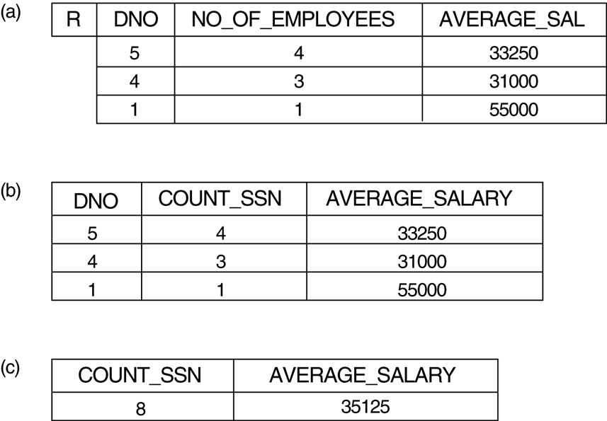


Aggregate Functions and Grouping

Slide 51
Aggregate Functions and Grouping
Use of the Functional operator ℱ
ℱ_{MAX Salary} (Employee) retrieves the maximum salary value from the Employee relation
ℱ_{MIN Salary} (Employee) retrieves the minimum Salary value from the Employee relation
ℱ_{SUM Salary} (Employee) retrieves the sum of the Salary from the Employee relation
_{DNO} ℱ_{COUNT SSN, AVERAGE Salary} (Employee) groups employees by DNO (department number) and computes the count of employees and average salary per department.[ Note: count just counts the number of rows, without removing duplicates]

Slide 52
Query example
List the names of all employees with two or more dependents.
T1(Ssn, No_of_dependents) ← _{Essn} ℑ _{COUNT(Dependent_name)} (DEPENDENT)
T2 ← σ _{No_of_dependents>=2} (T1)
RESULT ← π _{Lname, Fname} (T2 * EMPLOYEE)

Slide 53
Recursive Closure Operations
This operation is applied to a recursive relationship between tuples of the same type, such as the relationship between an employee and a supervisor
To specify the Ssn of all employees e’ directly supervised—at level one—by the employee e whose name is ‘James Borg’, we can apply the following operation:
BORG_SSN ← π _{Ssn} (σ _{Fname=‘James’ ANDLname=‘Borg’}(EMPLOYEE))
SUPERVISION(Ssn1, Ssn2) ← π _{Ssn,Super_ssn} (EMPLOYEE)
RESULT1(Ssn) ← π _{Ssn1}(SUPERVISION _{Ssn2=Ssn} BORG_SSN)
To retrieve all employees supervised by Borg at level 2—that is, all employees e’’ supervised by some employee e’ who is directly supervised by Borg—we can apply another JOIN to the result of the first query, as follows:
RESULT2(Ssn) ← π _{Ssn1} (SUPERVISION Ssn2=Ssn RESULT1)

Slide 54
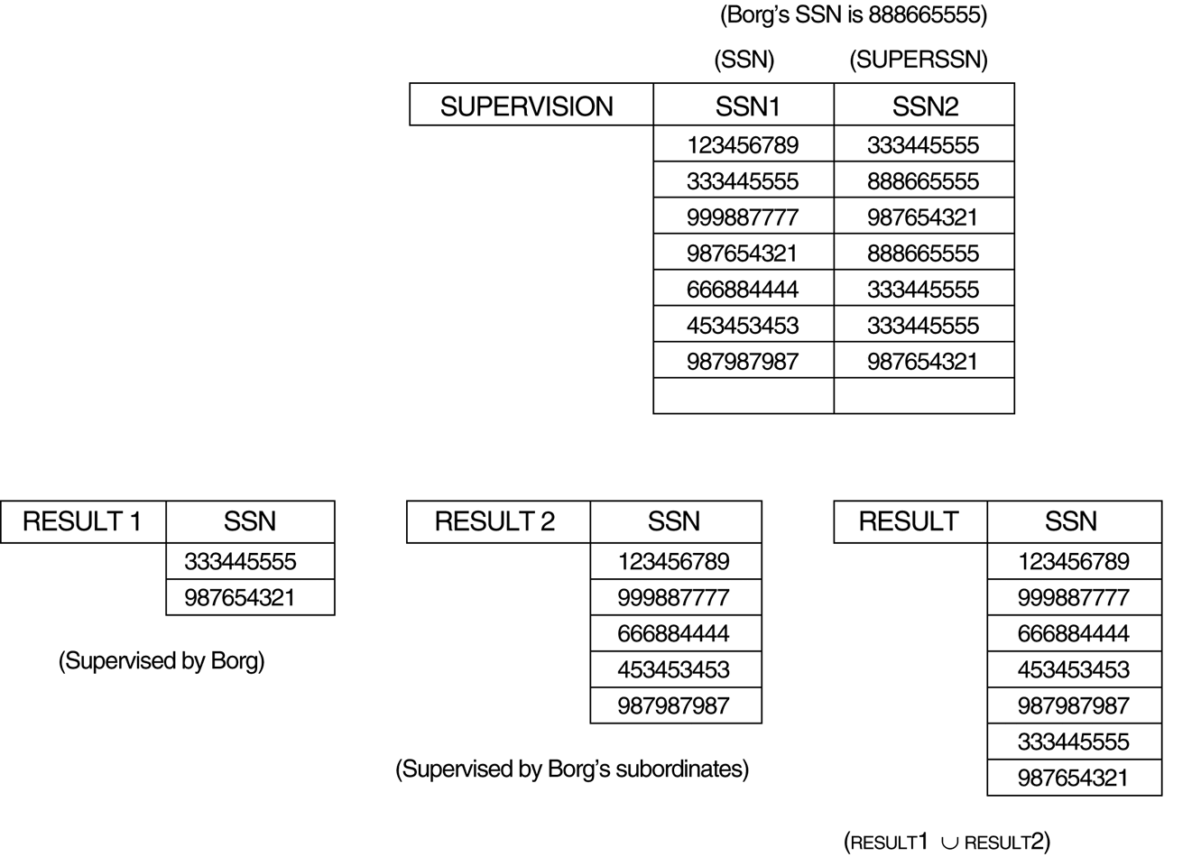
Recursive Closure Operations
To get both sets of employees supervised at levels 1 and 2 by ‘James Borg’

Slide 55
The OUTER JOIN Operation
In NATURAL JOIN tuples without a matching (or related) tuple are eliminated from the join result. Tuples with null in the join attributes are also eliminated. This amounts to loss of information.
A set of operations, called outer joins, can be used when we want to keep all the tuples in R, or all those in S, or all those in both relations in the result of the join, regardless of whether or not they have matching tuples in the other relation.
The left outer join operation keeps every tuple in the first or left relation R in R S; if no matching tuple is found in S, then the attributes of S in the join result are filled or “padded” with null values.
A similar operation, right outer join, keeps every tuple in the second or right relation S in the result of R S.
A third operation, full outer join, denoted by keeps all tuples in both the left and the right relations when no matching tuples are found, padding them with null values as needed.

Slide 56
The LEFT OUTER JOIN Operation
SINHVIEN
SV_LOP
Masv | Ho | Dem | Ten
T1 | Trần | Văn | An
C1 | Trần | Văn | Đức
C2 | Lê | Đình | Bắc
T3 | Trần | Thị | Hảo
T4 | Vũ | Đức | Lâm
C3 | Phạm | Hải | Ngọc
T2 | Lê | Thị | Hà
Masv | Malop | Diem
T1 | Int1001 | 8
C2 | Int1003 | 7
T3 | Int1003 | 10
T4 | Int1002 | 8
R = πSINHVIEN.Masv,Ho,Dem,Ten,Malop,Diem (SINHVIEN _{f} SV_LOP)
với f là SINHVIEN.Masv=SV_LOP.Masv
SINHVIEN.Masv | Ho | Dem | Ten | Malop | Diem
T1 | Trần | Văn | An | Int1001 | 8
C2 | Lê | Đình | Bắc | Int1003 | 7
T3 | Trần | Thị | Hảo | Int1003 | 10
T4 | Vũ | Đức | Lâm | Int1002 | 8
C1 | Trần | Văn | Đức | null | null
C3 | Phạm | Hải | Ngọc | null | null
T2 | Lê | Thị | Hà | null | null

Slide 57
The RIGHT OUTER JOIN Operation
SV_LOP
SINHVIEN
Masv | Ho | Dem | Ten
T1 | Trần | Văn | An
C1 | Trần | Văn | Đức
C2 | Lê | Đình | Bắc
T3 | Trần | Thị | Hảo
T4 | Vũ | Đức | Lâm
C3 | Phạm | Hải | Ngọc
T2 | Lê | Thị | Hà
Masv | Malop | Diem
T1 | Int1001 | 8
C2 | Int1003 | 7
T3 | Int1003 | 10
T4 | Int1002 | 8
R = πSINHVIEN.Masv,Ho,Dem,Ten, Malop,Diem, (SINHVIEN _{f} SV_LOP)
với f là SINHVIEN.Masv=SV_LOP.Masv
SINHVIEN.Masv | Ho | Dem | Ten | Malop | Diem
T1 | Trần | Văn | An | Int1001 | 8
C2 | Lê | Đình | Bắc | Int1003 | 7
T3 | Trần | Thị | Hảo | Int1003 | 10
T4 | Vũ | Đức | Lâm | Int1002 | 8

Slide 58
The OUTER JOIN Operation
OUTER UNION Operations
The outer union operation was developed to take the union of tuples from two relations if the relations are not union compatible.
This operation will take the union of tuples in two relations R(X, Y) and S(X, Z) that are partially compatible, meaning that only some of their attributes, say X, are union compatible.
The attributes that are union compatible are represented only once in the result, and those attributes that are not union compatible from either relation are also kept in the result relation T(X, Y, Z).
Example: An outer union can be applied to two relations whose schemas are STUDENT(Name, SSN, Department, Advisor) and INSTRUCTOR(Name, SSN, Department, Rank). Tuples from the two relations are matched based on having the same combination of values of the shared attributes—Name, SSN, Department. If a student is also an instructor, both Advisor and Rank will have a value; otherwise, one of these two attributes will be null.
The result relation STUDENT_OR_INSTRUCTOR will have the following attributes:
STUDENT_OR_INSTRUCTOR (Name, SSN, Department, Advisor, Rank)

Slide 59


